Slide 1
NAAN MUDHALVAN BLOCKCHAIN PROJECT
Title : identity details
By,​ Jasmine.N​
Neha.R

Slide 2


Slide 3
Problem statement
Blockchain is a technology that enables identities to be stored transparently. It offers decentralized nodes for end-to-end verification advantages. This technology is a replacement for traditional identity management with distributed, nonrepudiation, and security protection characteristics.
Design a smart contract using the Ethereum blockchain where you should be able to store the identity details in the blockchain and should be able to query the details of the identity from the blockchain

Slide 4
approach
First step is to deploy the SmartContract using Remix IDE.After writing the code, compile the code. When it is successfully compiled then deploy it.
After deploying the contract, a deployed contract is obtained.
Add the user identity details into the appropriate fields present in the AddIdentity function.
To retrieve the details, which can be done only by the owner, use the GetIdentity function.
FUNCTIONALITIES
Storage of identity details
Retrieval of the details by Owner

Slide 5
introduction
This is a smart contract written in Solidity named as 'IdentityDetails'.
It allows users to add their identity details such as name, date of birth, email, phone, and address to the blockchain.
The contract stores the details in a mapping with the user's address as the key.
The owner of the contract can view the stored identity details of any user by calling the `getIdentity` function.
This program can be used in various applications where user identity verification is required on the blockchain.

Slide 6
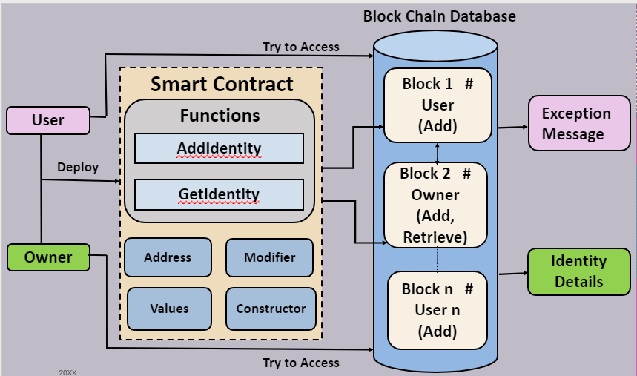
Architecture Diagram

Slide 7
The above is the architecture diagram for the IdentityDetails Etherium Smartcontract which uses Blockchain to store and retrieve data.
The SmartContract can be accessed by any number of users but only one person(owner) can retrieve the details. The diagram represents two users, owner and user. The owner is the one who deploys the contract first. Only the owner can retrieve the details of other users. The users can only add their details.
The Smart Contract consists of various elements such as :
Functions(AddIdentity,GetIdentity)
Modifier
Constructor
Etherium Addresses
It uses a struct and a mapping to store the identity information, and has functions to add and retrieve this information.

Slide 8
The `addIdentity()` function allows a user to add/update their own identity information to the mapping, while the `getIdentity()` function allows the contract owner to view any user's identity information.​
The contract also has a modifier that restricts access to the retrieval function to the contract owner.​
It has a constructor which sets the owner variable to the address that deployed the contract​.
After the smart contract is executed and the input is given into the functions and transacted, the data of owner is stored in block 1 in the blockchain and the data of user2 is stored in block 2.
This block chain is stored in the blockchain database. ​
When a user tries to access the details of other users using the GetIdentity function, an exception message will be shown. If the user is the owner, and if he tries to access the BlockChain, Identity details of other users will be displayed.​
​

Slide 9

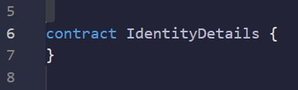
This line specifies the version of solidity being used in the contract. in this case, the contract uses version 0.8.0 or higher.
This line defines the start of a new contract called IdentityDetails.
A contract is a collection of functions and data that are stored on the Ethereum blockchain and can be accessed by anyone who has permission to interact with it.
This contract allows users to add and retrieve identity details

Slide 10
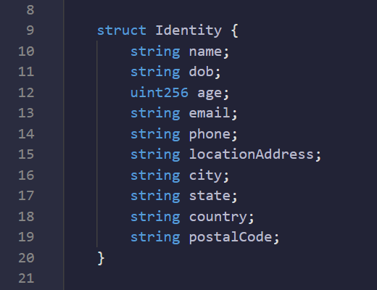
These lines define a new custom data type called Identity.
The Identity struct has 10 properties, each having a specific data type.
It allows multiple identity details to be stored and organized within the contract.
It is used in conjunction with the mapping(address => Identity) private identities data structure, which maps Ethereum addresses to their corresponding Identity structs.
Together, the Identity struct and mapping data structure allow users to add and retrieve identity details within the this contract.

Slide 11


This line defines a mapping called identities that maps ethereum addresses to identity records.
This mapping is private, meaning it can only be accessed by functions within the contract.
This line defines a public Ethereum address variable called owner, which represents the owner of the contract.

Slide 12
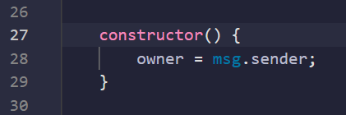
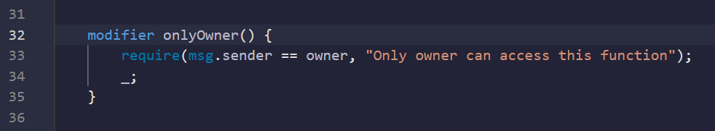
This is a constructor function, which is executed only once when the contract is created.
It sets the owner variable to the address that deployed the contract.
This is a modifier function that restricts access to certain functions in the contract to only the owner of the contract.
It checks whether the Ethereum address that called the function matches the owner address. If it doesn't, an error message is returned.

Slide 13
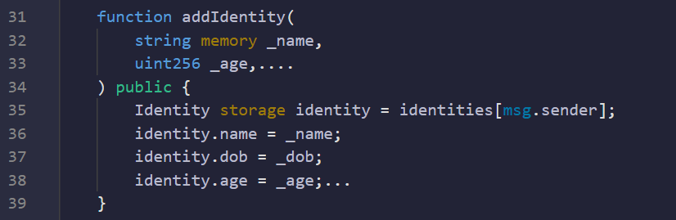
This is a public function called addIdentity() that allows a user to add or update their identity details to the identities mapping using their Ethereum address as the key.The function takes ten string and uint256 input parameters corresponding to the properties defined in the Identity struct.
The function first retrieves the Identity struct associated with the Ethereum address of the caller using the identities[msg.sender] expression.Since the identity variable is a pointer to the Identity struct in storage, any changes made to its properties will also modify the corresponding values in the identities mapping.
Therefore,when the function updates the Identity struct, it also updates the identity details stored in the identities mapping for the Ethereum address that called the function.

Slide 14
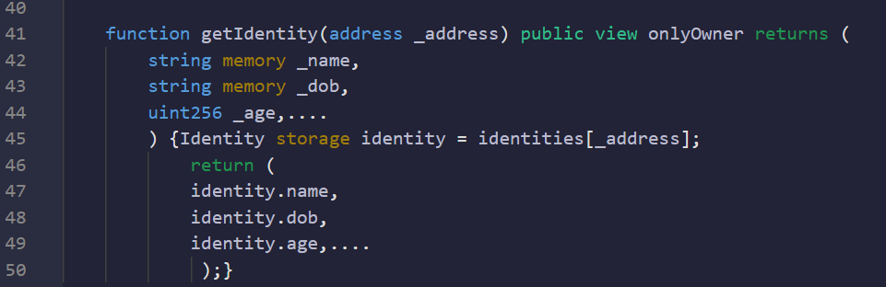
This is a public function called getidentity() that retrieves the identity details of a specific user based on the ethereum address provided as an input parameter.
The function takes an address input parameter _address that is used as a key to retrieve the identity struct associated with the provided ethereum address from the identities mapping.
The function returns a tuple of string and uint256 values corresponding to the properties defined in the identity struct. These values represent the current stored values for the identity details of the user associated with the provided ethereum address.
The function is also marked with the onlyowner modifier, which ensures that only the contract owner can retrieve the identity details of any user.

Slide 15
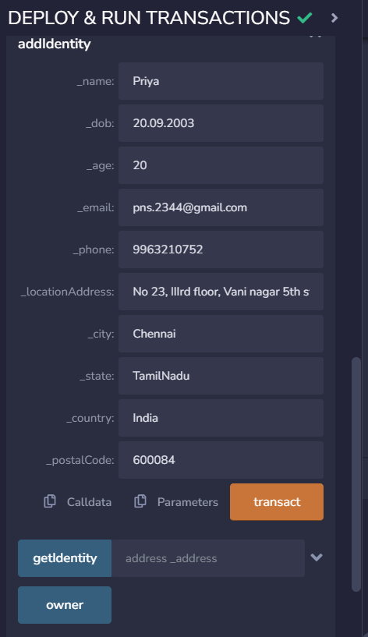
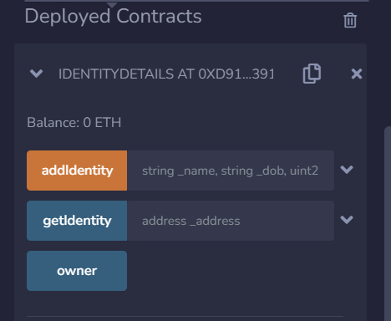
OUTPUT

Slide 16
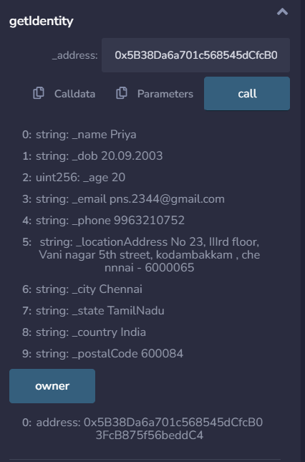
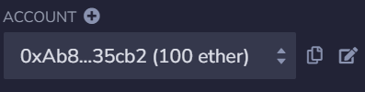
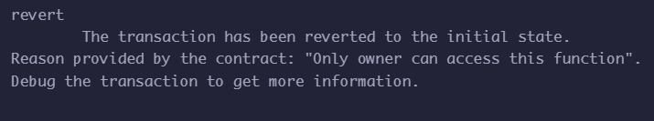

Slide 17
THANK YOU

